Slide 1

@RLadiesMelb
R-Ladies: An update on the local and wider picture
Anna Quaglieri - 30th Nov 2018 - BioC Asia 2018
Notes:
"I would like to acknowledge the Wurundjeri people of the Kulin nation who are the traditional custodians of the land on which Melbourne campus stands.
I would also like to pay respect to the Wurundjeri Elders, past and present, and extend this respect to Aboriginal and Torres Strait people from other communities who are here today ".

Slide 2
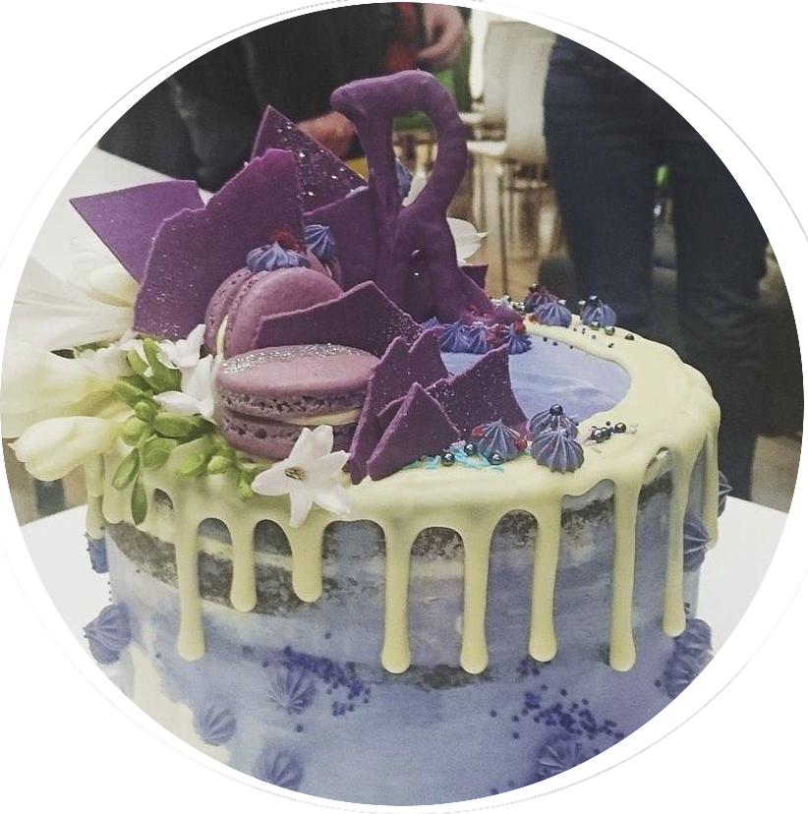


Slide 3

R-Ladies Objectives
rladies.org/about-us/

Slide 4
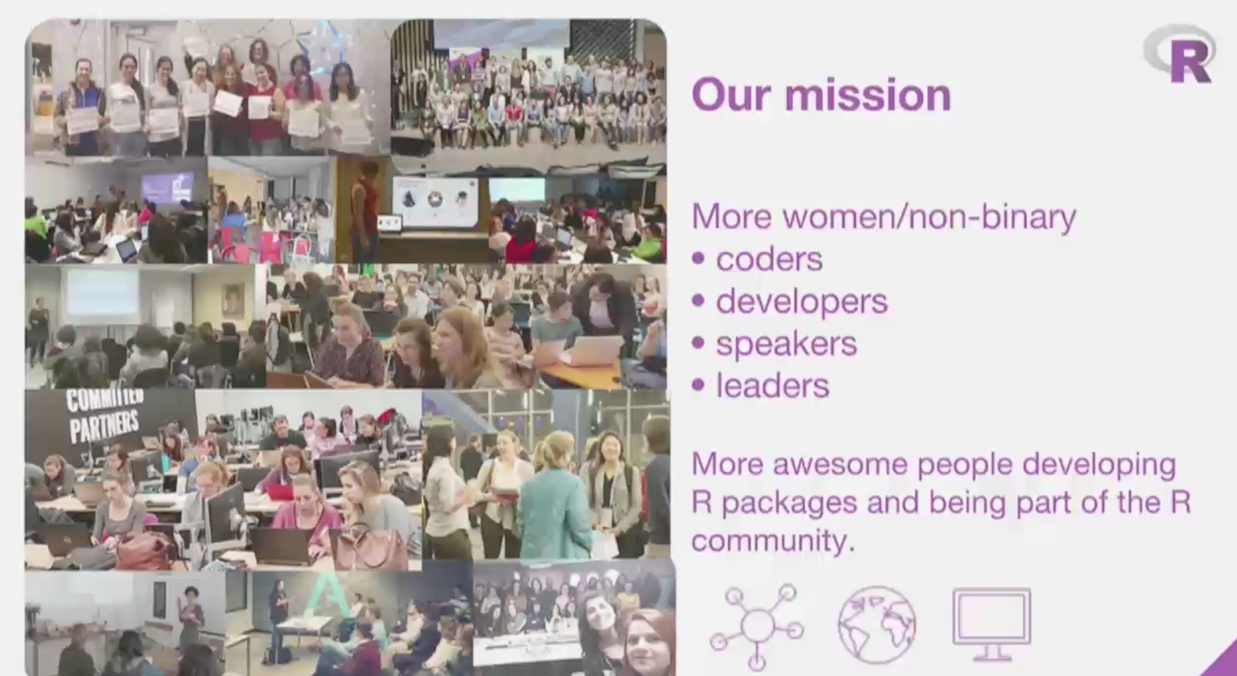
R-Ladies Objectives
rladies.org/about-us/
Notes:
Alice Daish and Hannah Frick from the R-Ladies global team

Slide 5
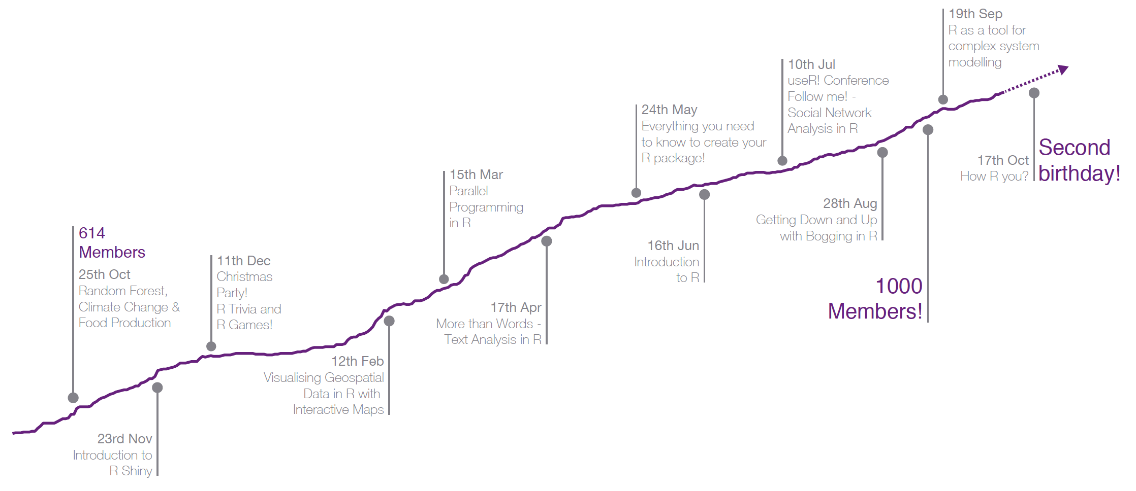
October 2017 - October 2018

Slide 6
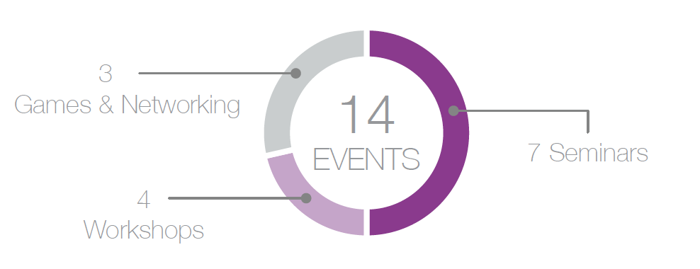
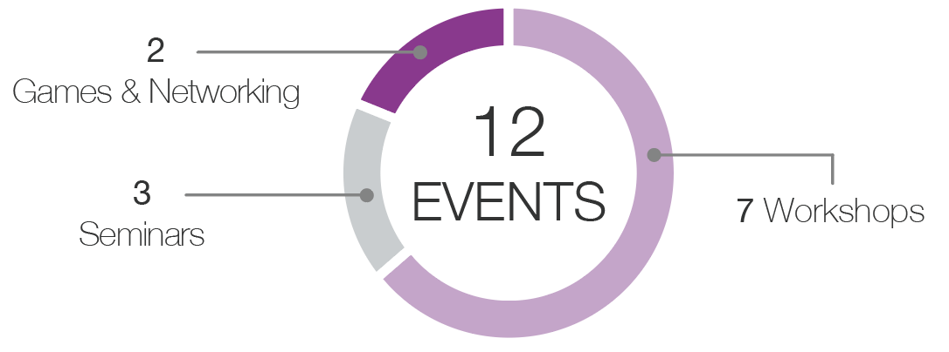
October 2017 - October 2018
October 2016 -
October 2017

Slide 7
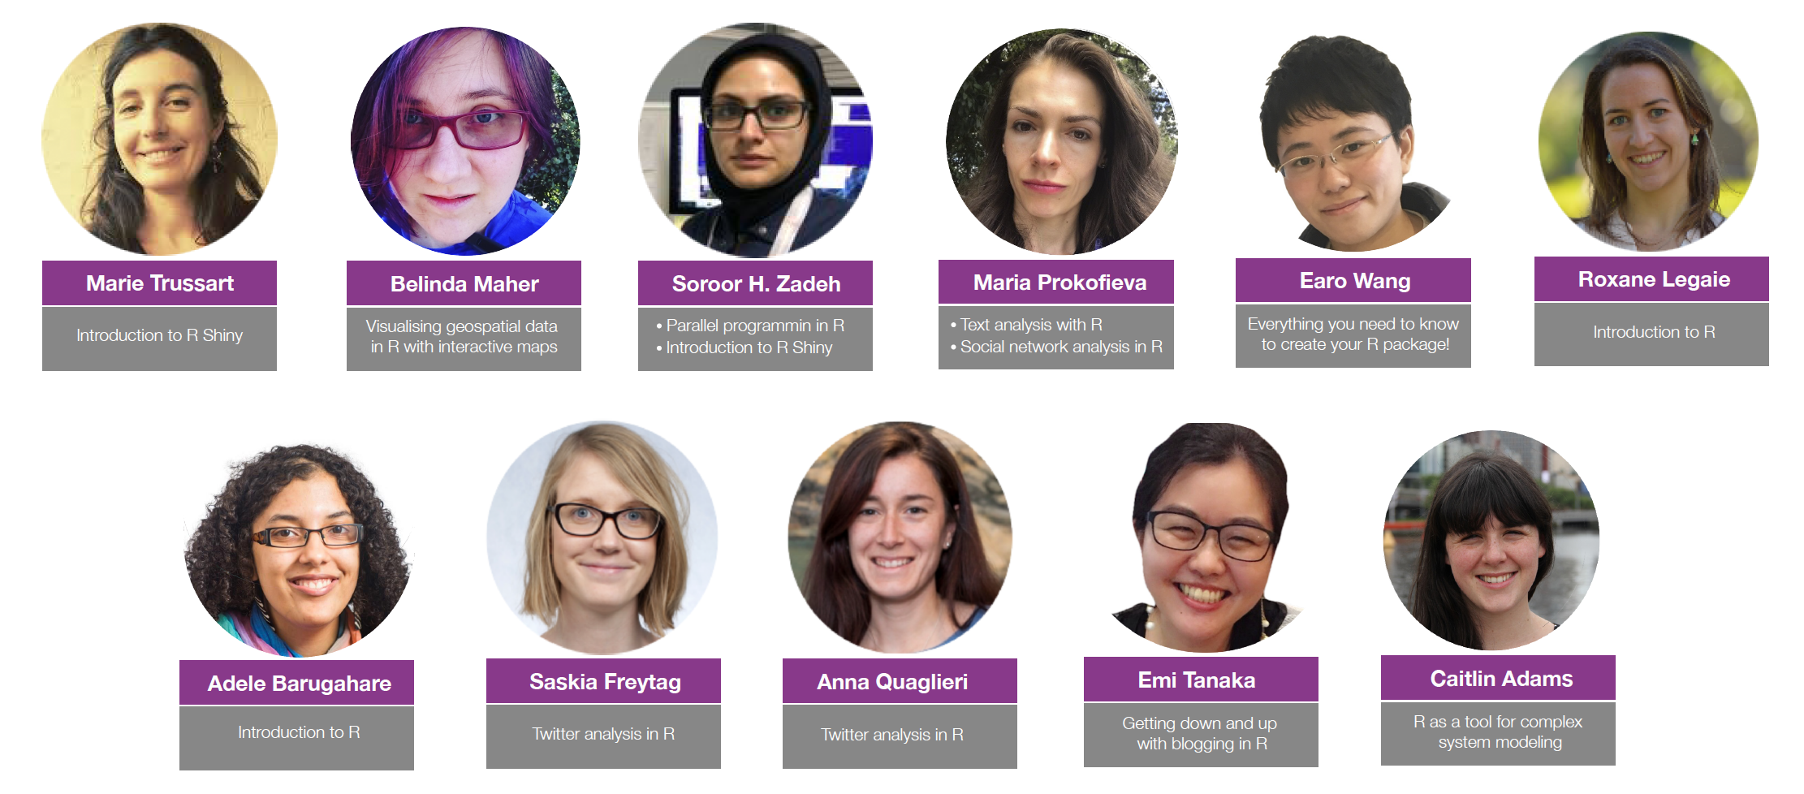
October 2017 - October 2018
github.com/R-LadiesMelbourne/Links-to-Events-Repos

Slide 8
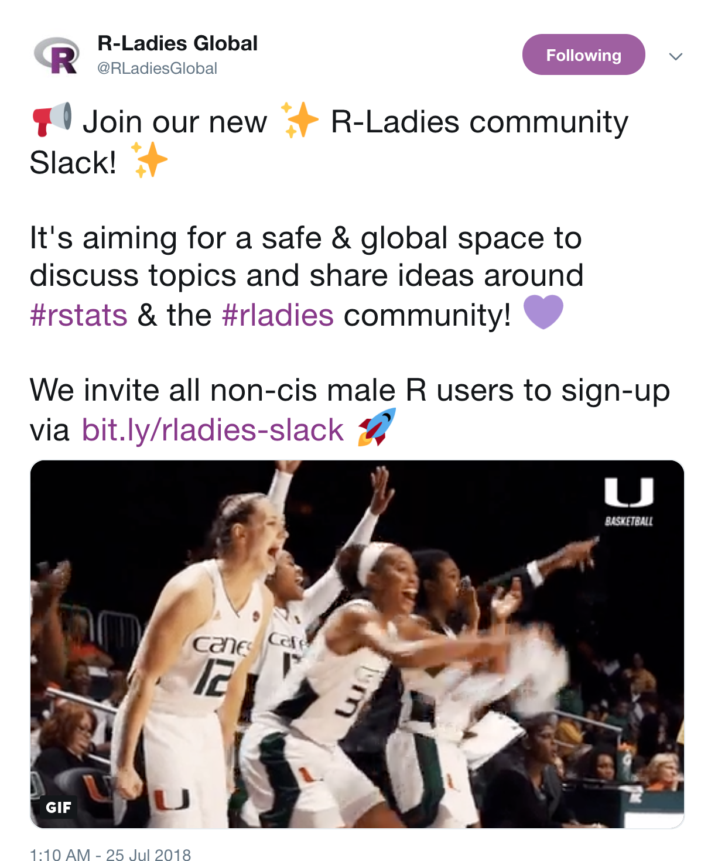
Connect with R-Ladies around the world
Sign up at: https://rladies-community-slack.herokuapp.com/

Slide 9
Highlights from this year…

Slide 10
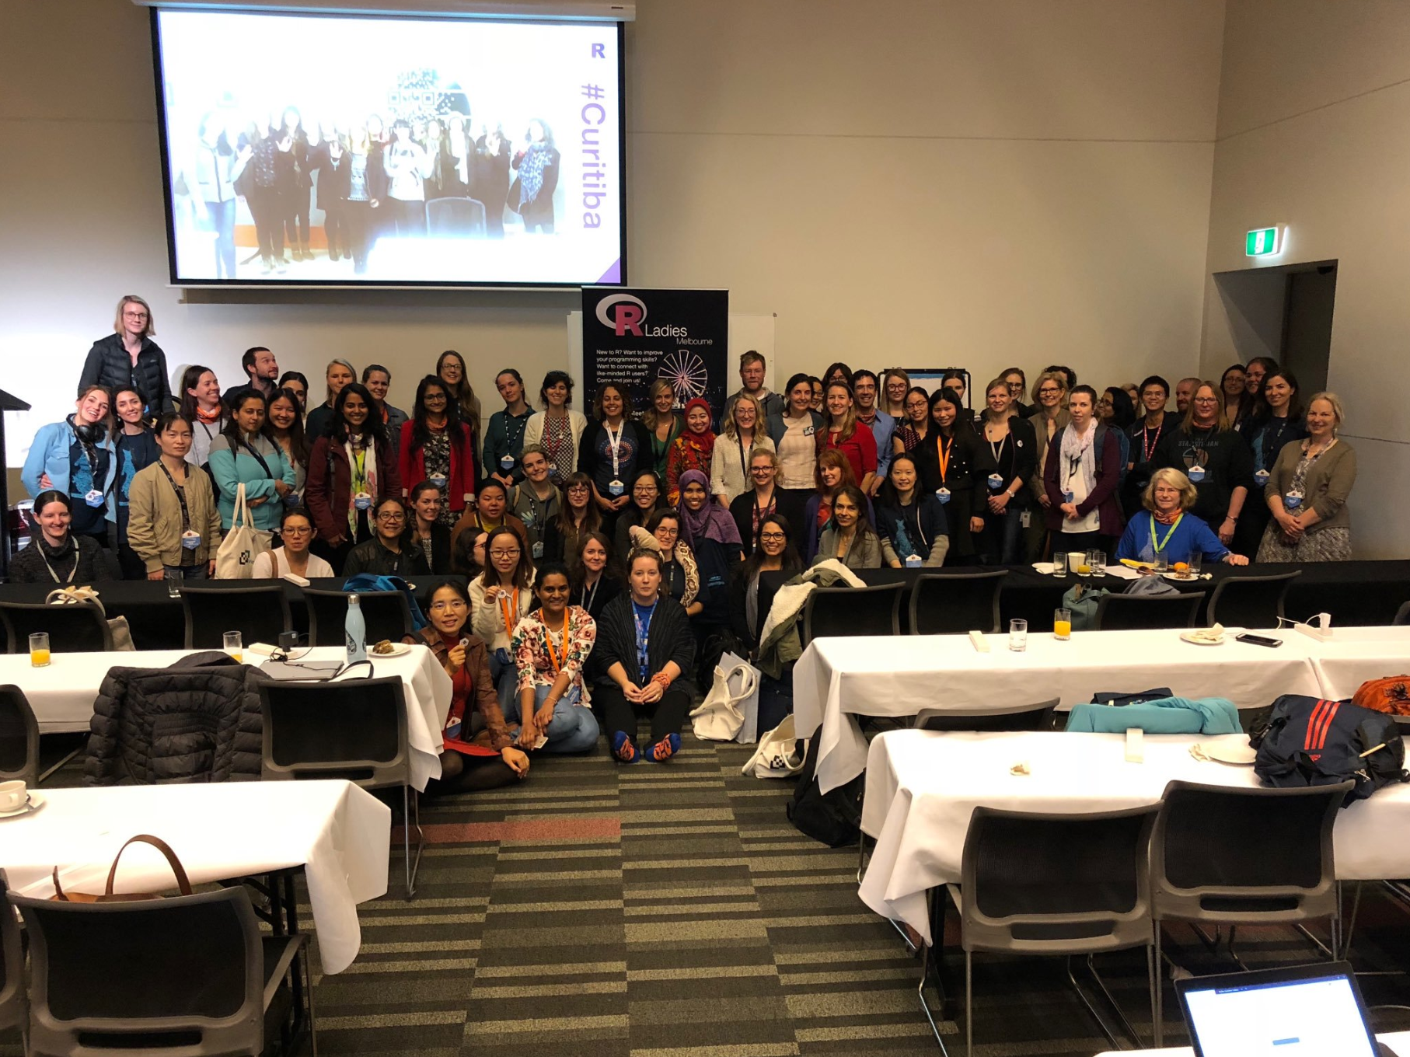
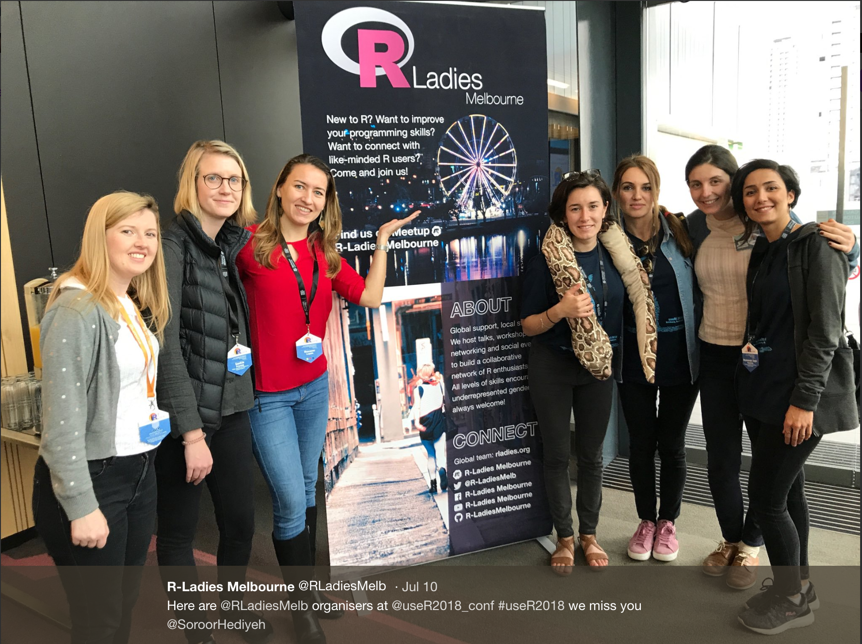
useR! 2018 Conference

Slide 11
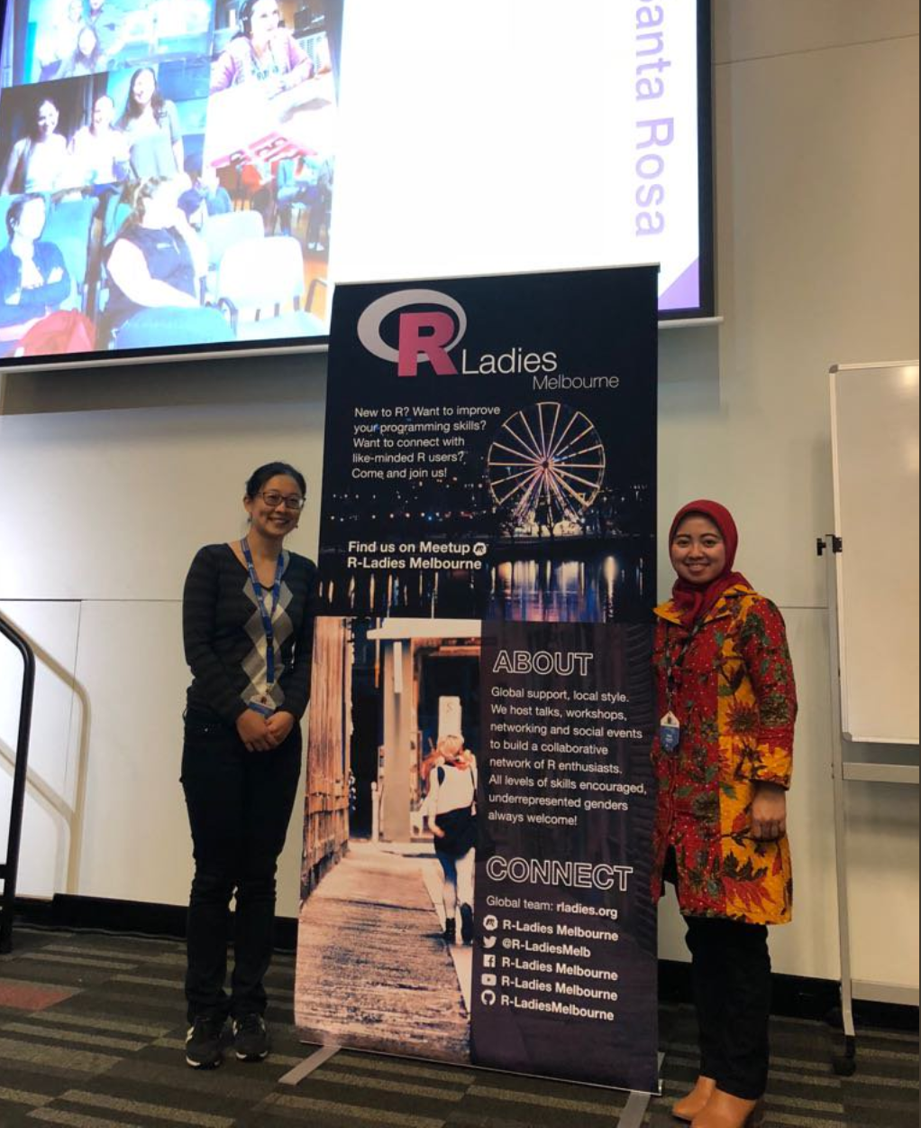

useR! Conference
R-Ladies Melbourne granted two scholarship for useR! to:
Lucy Liu
Dewi Anggraini
This was thanks to the sponsorship by

Slide 12
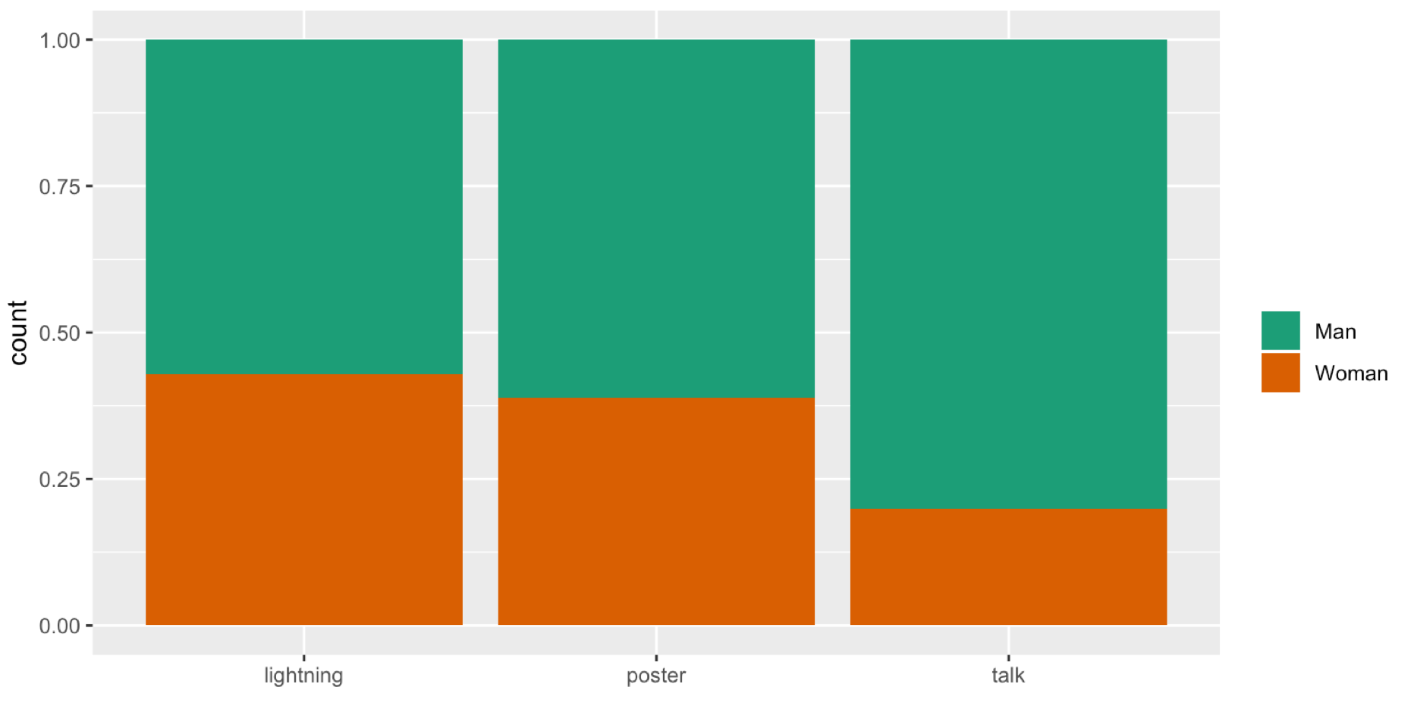
useR! 2018 Statistics
(based on survey results)
283/600 (47% vs 51.8% in 2017) response rate to the survey
For 276/600 (46% vs 51% useR! 2017) we have gender data
69.6% man
28.6% women (~27% in useR! 2017, ~33% in 2016)
1.8% gender diverse
25% women gave a talk (27.6% in 2017) 23% exact estimate from abstract submission.
Gender diverse participants were represented in 1 talk and 1 lightning talk
14 lightning talks (estimate to be updated)
18 posters (estimate to be updated)
75 talks

Slide 13

useR! Conference
New sponsor!

Slide 14
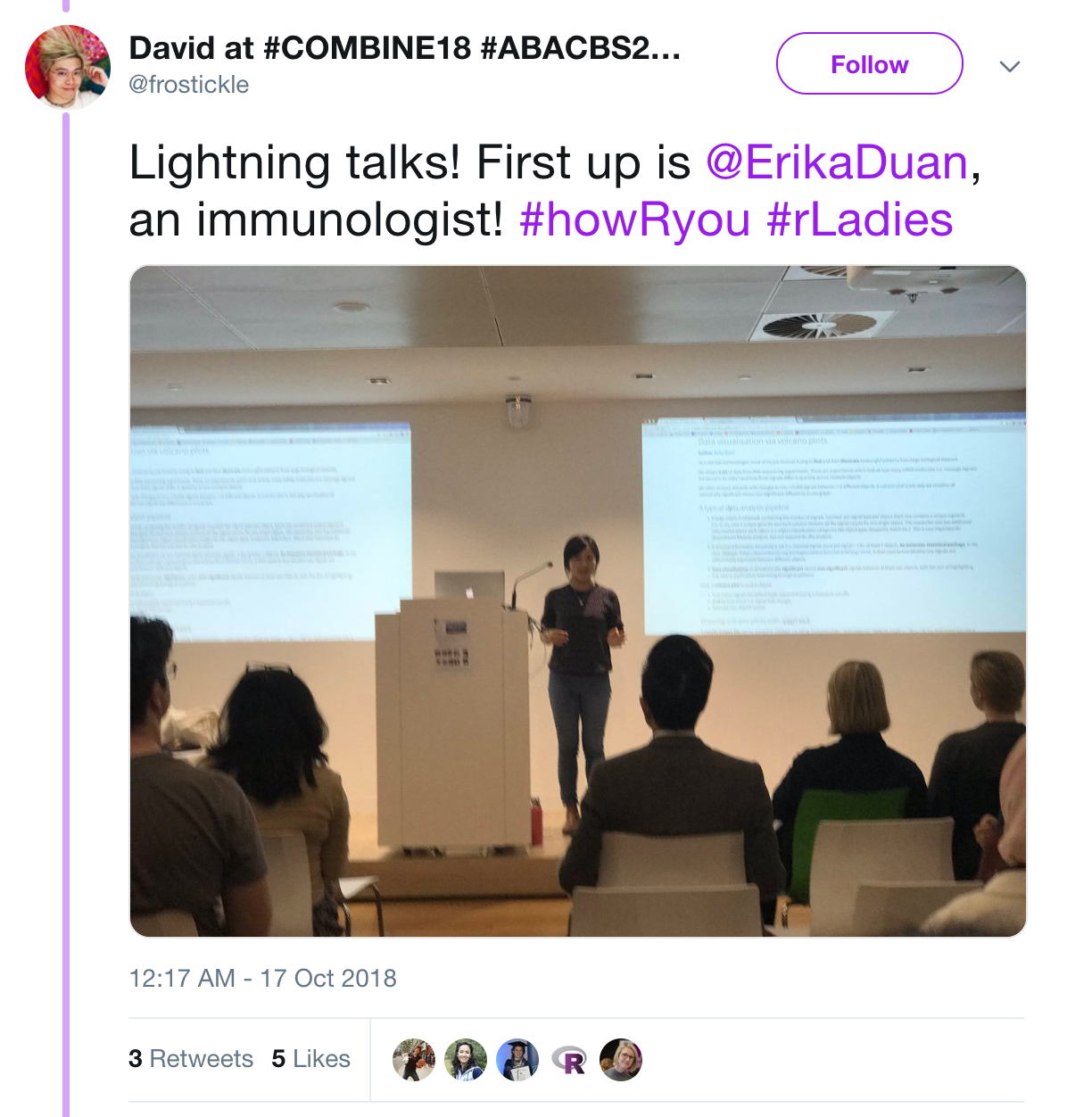
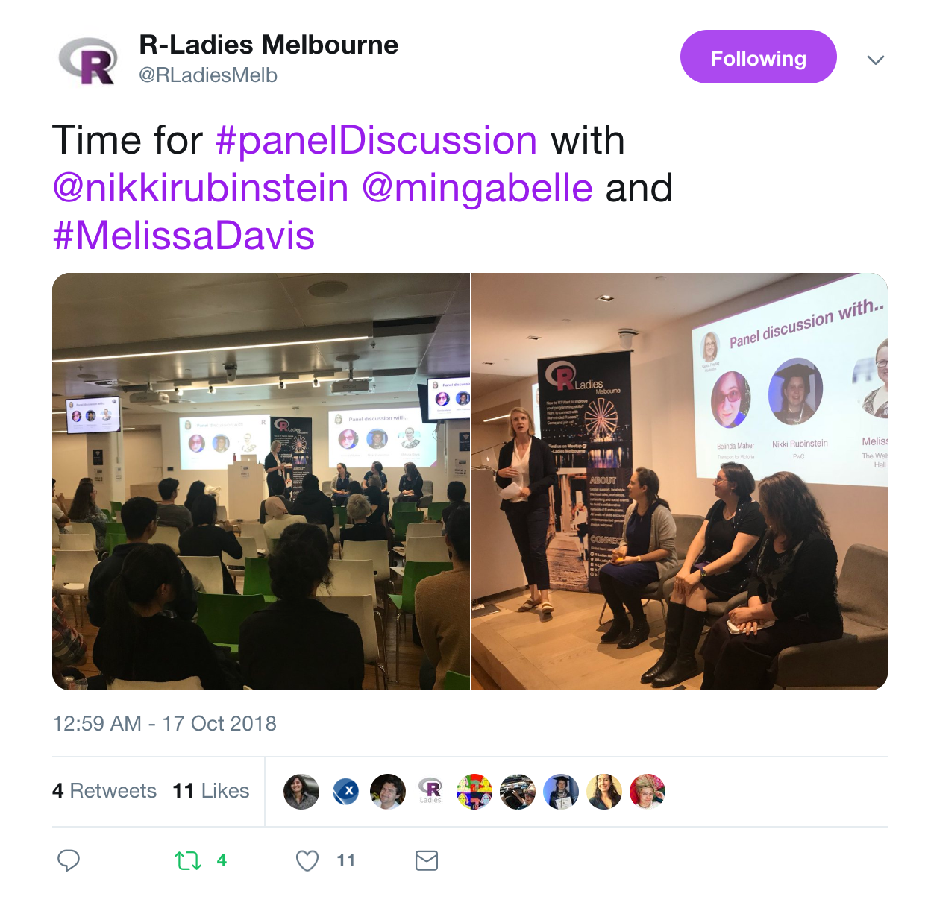
First small conference…
How R you?

Slide 15
How R you? Website
https://rladies-melbourne-tips.netlify.com/

Slide 16
In January we will incorporate and become a registered association!

Slide 17
We are always looking for speakers!

Slide 18
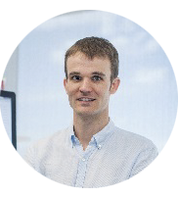


A big thank...
To our faithful sponsors
Matt Ritchie
Notes:
CSL provides funding for events, they extended their support for the next Zendesk provides us space and drinks for some of our events, WEHI - occasional location for meetings and events

Slide 19
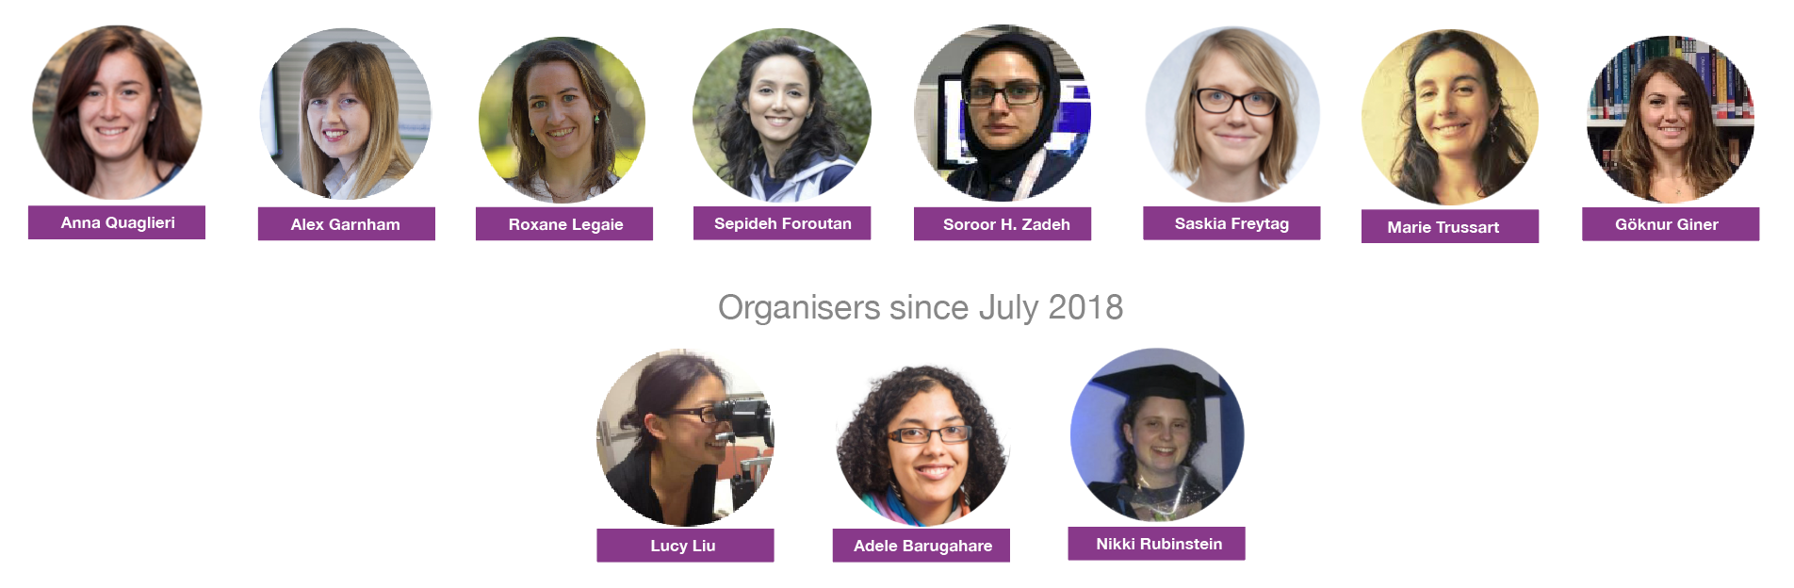
... To all the organisers for their time!

Slide 20
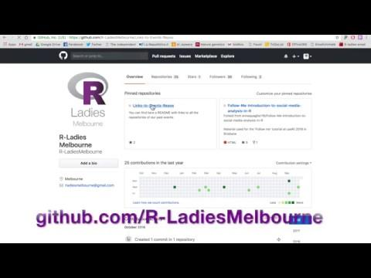
Connect with R-Ladies around the world

Slide 21
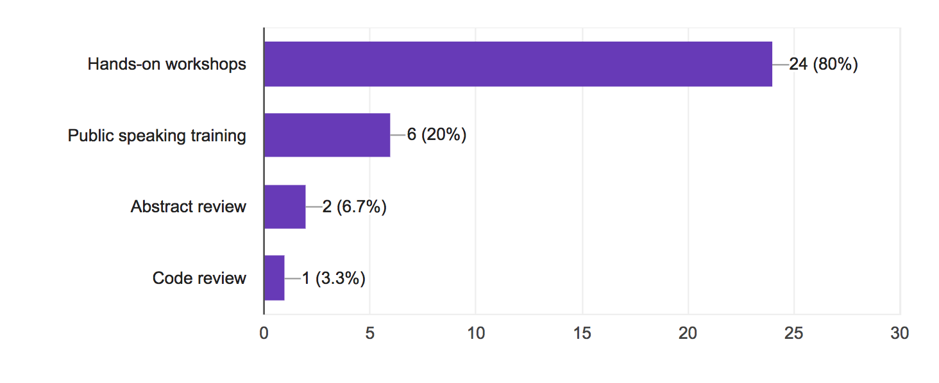
February 2018 Survey
How could we support women even better?
(30 responses)

